Slide 1
Sign language Translator
‘’Breaking Barriers: Building a Bridge Between Sign Language and Spoken Language’’

Slide 2
Group Members
Name | Registration No.
Aditya Routh | 22BAI10030
Sounak Dutta | 22BAI10210
Ritam Goswami | 22BAI10413
Sneha Sarkar | 22BAI10350
Rishbah Kumar Singh | 22BAI10411

Slide 3
Problem Statement
Develop a system that can accurately recognize and interpret sign language gestures, bridging communication gaps between hearing-impaired individuals and others.
Develop a hand sign translator application using Python.
Translate hand signs into text.
Improve accessibility and communication for hearing-impaired individuals.

Slide 4
Process
Data Collection:
Gather a dataset of hand sign images or videos.
Consider using existing datasets or creating a custom one.
Data Preprocessing:
Clean and prepare the data for machine learning.
Convert the images into numpy arrays, and store them in a dataset along with their corresponding labels.
Tasks may include segmentation, normalization, and feature extraction.

Slide 5
Model Development:
Choose a machine learning algorithm (e.g., Random Forest).
Develop and train the model using Python libraries like Scikit-learn.
Image to Video image capture
Code can detect our sign language and show the letter.
Easy to learn the letter and words.

Slide 6
Testing and Refinement:
Evaluate the model's accuracy on unseen data.
Refine the model based on testing results.
Whatever Sign language we are showing it is giving the right letters or not.
Deployment (Optional):
Develop a user interface for the translator application

Slide 7
RESOURCES
Python - A versatile and beginner-friendly programming language.
Extensive libraries for machine learning and computer vision:
OpenCV - Library for real-time computer vision tasks.(image processing)
Matplotlib - data visualization library
Scikit-learn – A free software machine learning library for the Python programming language.
Mediapipe - Mediapipe documentation for hand tracking. https://mediapipe.readthedocs.io/en/latest/solutions/hands.html

Slide 8
APPLICATION
Improved Accessibility: Bridge the communication gap between hearing-impaired and general population.
Educational Tool: Assist in learning sign language for both deaf and hearing individuals.
Social Inclusion: Enable smoother communication in social interactions and events.
Assistive Technology: Potential for use in scenarios where speech is difficult or impossible.

Slide 9
REVIEW 2 CODE WHICH IS JUST CAPTURING THE PICTURE AND DETECT THE SIGN LANGUAGE.

Slide 10
CODE FOR COLLECTING IMAGES

Slide 11
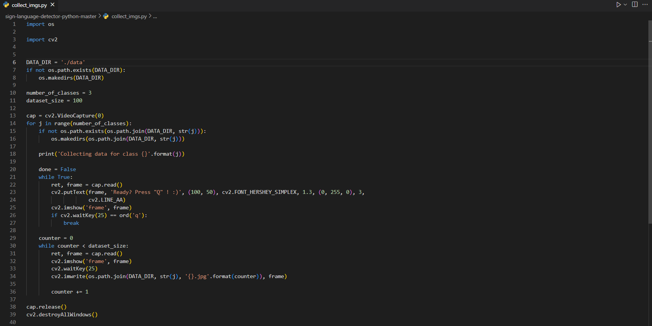

Slide 12
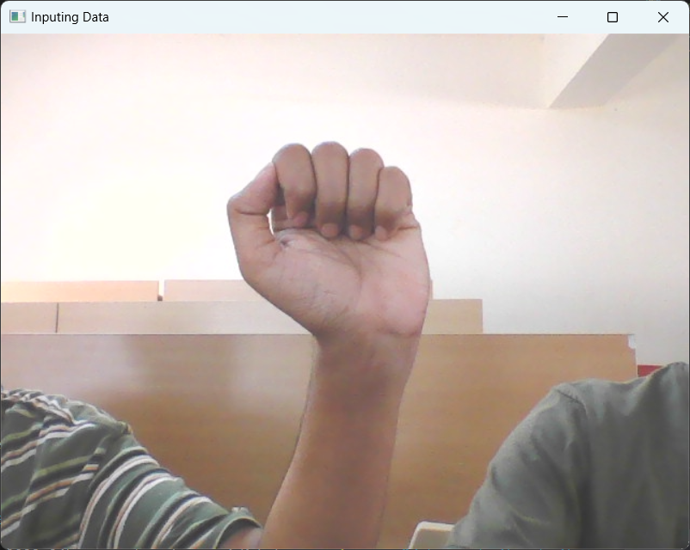
This is how our input frame will look like:
On Pressing “s” it will start taking sample images.
It will take 100 sample images of a particular dataset

Slide 13
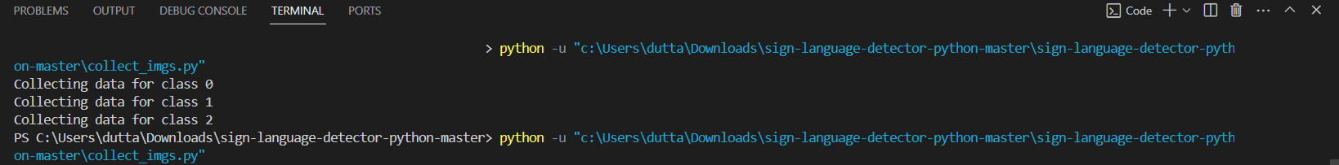
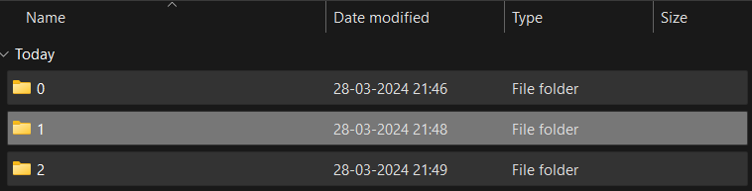
The Dataset is saved into files. Each file consisting of individual hand-sign.

Slide 14
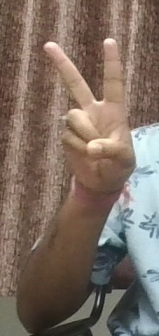
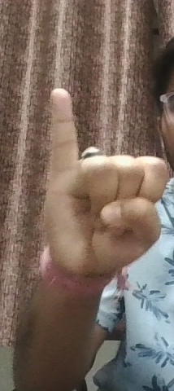
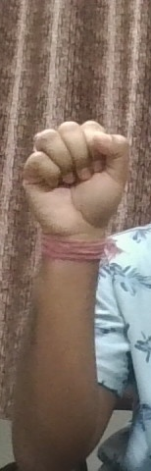
V I t
SIGNS:
SAMPLE DATA-SETS

Slide 15
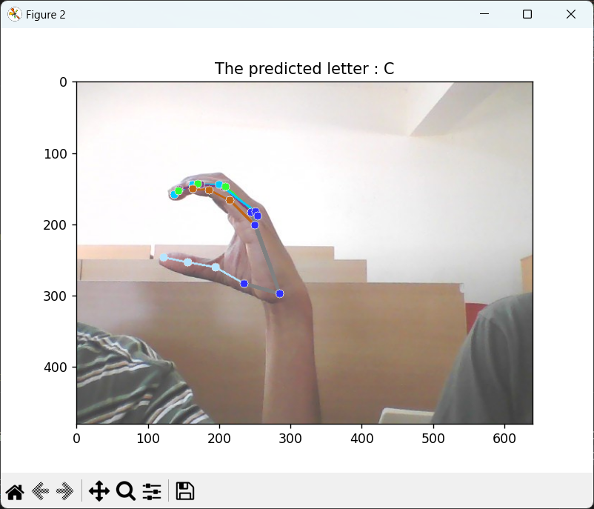
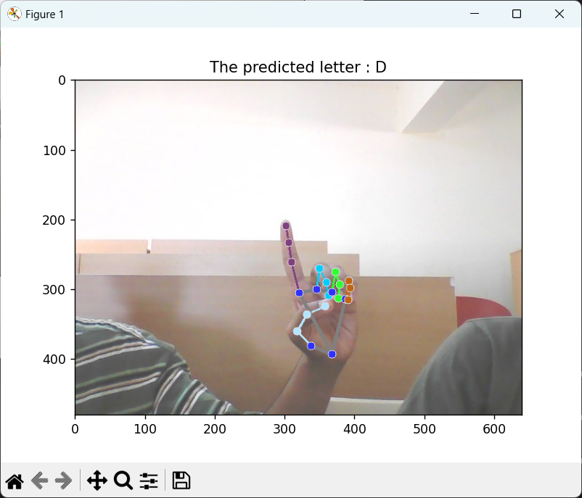
results
After developing the model, we tested It on a few still images, and got the following Results.

Slide 16
COMPILING THE MODIFICATION AFTER REVIEW 2. NOW WE ARE PRESENTING OUR FINAL OUTPUT IN REVIEW 3.

Slide 17
CODE FOR CAPTURING THE VIDEO AND GIVE A PROPER OUTPUT OF LETTER DETECTION OF THAT SIGN

Slide 18
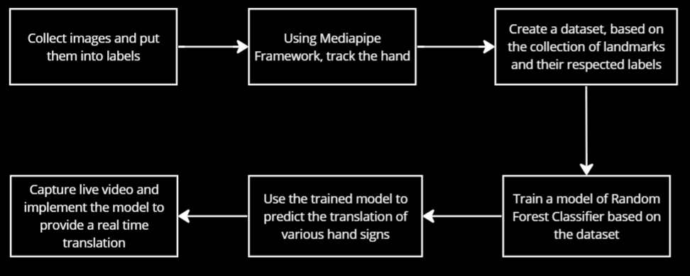
flowchart

Slide 19
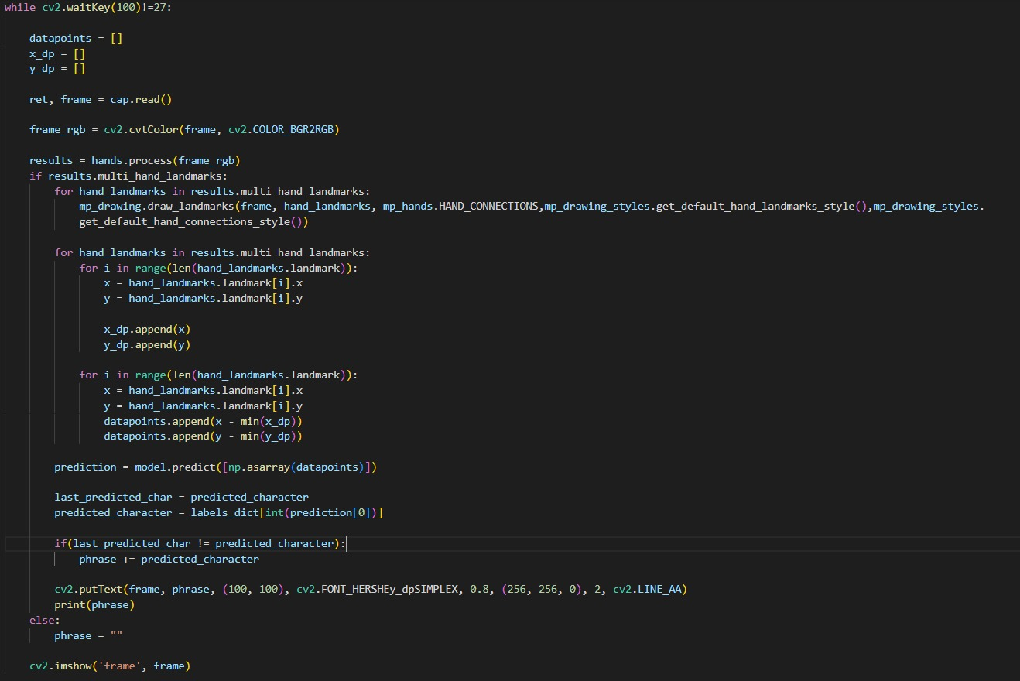

Slide 20
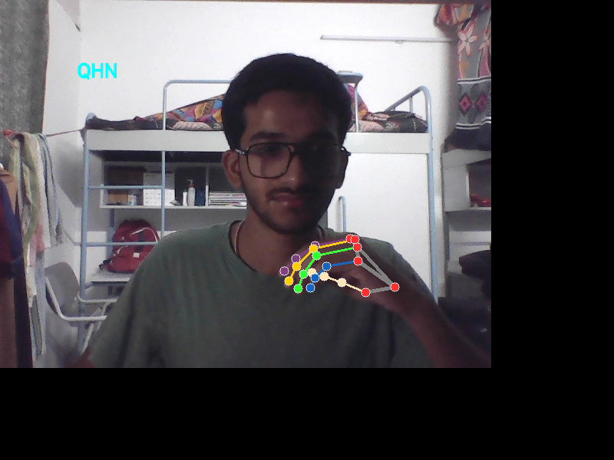
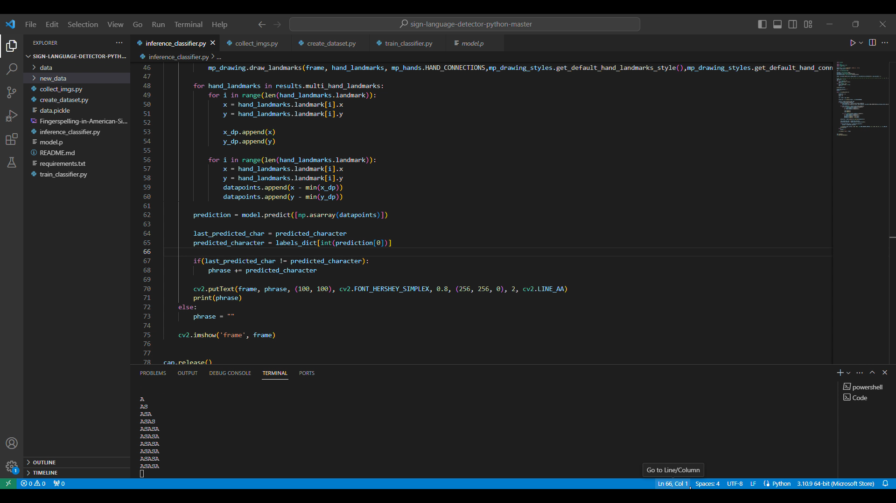
OUTPUT
User is giving the sign as input and we are getting the letters as output.

Slide 21
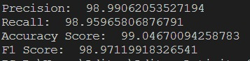
ACCURACY
As we can see while training we found 100% training accuracy.

Slide 22
CONCLUSION
Using the ML algorithm Random Forest, we made a way to convert sign language into text output.
This has the potential to help the people with speaking or hearing aids communicate even without a human translator

Slide 23
THANK YOU

